Slide 1




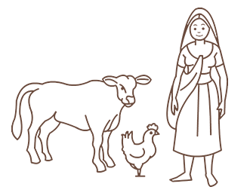
Session-3
Lakhpati Livelihood
Notes:
This section will focus on understanding the concepts and elements of sustainable livelihoods.

Slide 2
Discussion Points
01
What is Livelihood for Lakhpati Didis?
Livelihood and Factors affecting Livelihoods at HH level
02
Potential Opportunities for Lakhpati
Farm & Allied, NTFP, Non-Farm, services, skills
03
How to choose the right intervention?
Checklist for Lakhpati Decision at HH Level.
04
Queries And Observations

Slide 3


What is Livelihood for Lakhpati didi?
Each participant to share their understanding of livelihood and name few examples of livelihood activities
Lakhpati Livelihoods
Opportunities
Choosing Right Activity
Queries and Observation

Slide 4
Understanding Lakhpati Livelihoods
A set of economic activities: self-employment and/or wage-employment/ manufacturing/business, others
By using one’s endowments (human and material)
to generate adequate resources (cash and non-cash)
for meeting the requirements of self and the household,
carried out repeatedly and as such become a way of life.
Ideally
Livelihood keeps a person meaningfully occupied
In a sustainable manner
With Dignity
Lakhpati Livelihoods
Opportunities
Choosing Right Activity
Queries and Observation

Slide 5

In our understanding Livelihood is…
Examples …
1.
2.
3.
4.
5.
6.
7.
Lakhpati Livelihoods
Opportunities
Choosing Right Activity
HH Preparedness

Slide 6

List the Livelihood Activities of different Types
Farming- Agri | Farming- Horti | Other Farm Based | Animal Husbandry/ Fishery | NTFP | Non-Farm / Enterprises | Skills / Services | NRM Works
Lakhpati Livelihoods
Opportunities
Choosing Right Activity
HH Preparedness
Notes:
Activities spelled earlier will be classified in the major categories in this slide. This will be done through participatory discussion

Slide 7
Some Examples: LH Activities
Farming- Agri | Farming- Horti | Other Farm Based | Animal Husbandry/ Fishery | NTFP | Non-Farm / enterprises | Skills / Services | NRM Works
Cereals | Fruits | Mushroom | Cattle, Goat, Sheep, Pig rearing | Lac | Shops | Beautician | Gully Plugging
Pulses | Vegetables | Mulberry Sericulture | Poultry, Duck rearing | Bamboo | Enterprises | Plumber | Contour Bunding
Oilseeds | Spices | Ericulture | Fishery | Honey | Processing units | Electrician | Check Dams
Plantation Crops | Medicinal | Bee Keeping | Dairy | Tamarind |  | Jobs | Trenches
 | Floriculture |  |  | Silk - Tasar |  | Catering | Ponds
Lakhpati Livelihoods
Opportunities
Choosing Right Activity
HH Preparedness
Notes:
Activities spelled earlier will be classified in the major categories in this slide. This will be done through participatory discussion

Slide 8

What are the Characteristics of Livelihood Activities Affluent families are engaged with around you?
1
2
3
4
5
6
7
8
Lakhpati Livelihoods
Opportunities
Choosing Right Activity
HH Preparedness
Notes:
Participants will be asked the above questions by the facilitator,
Responses will be noted down

Slide 9
Characteristics: Good/ Lakhpati Livelihoods
Diversified
Regular
Sustainable
Safe and Healthy
Dignified: Culturally Acceptable, Legally Protected
Lakhpati Livelihoods
Opportunities
Choosing Right Activity
HH Preparedness
Notes:
Participants will be asked the above questions by the facilitator,
Responses will be noted down

Slide 10
For making a Didi Lakhpati
Strengthening of existing livelihood activities through value chain interventions (Removing all bottlenecks) Production (input, technology, practices, harvest) Value addition (grading, primary/secondary processing) Aggregation and Marketing (PG/PE etc) Other Diversify the livelihood sources to reduce impact of vulnerability Social Security strengthening as fallback support (life, health, crop, other insurances, Pensions, other entitlements)
Lakhpati Livelihoods
Opportunities
Choosing Right Activity
HH Preparedness

Slide 11
Potential Livelihood Opportunities
Lakhpati Livelihoods
Opportunities
Choosing Right Activity
HH Preparedness

Slide 12
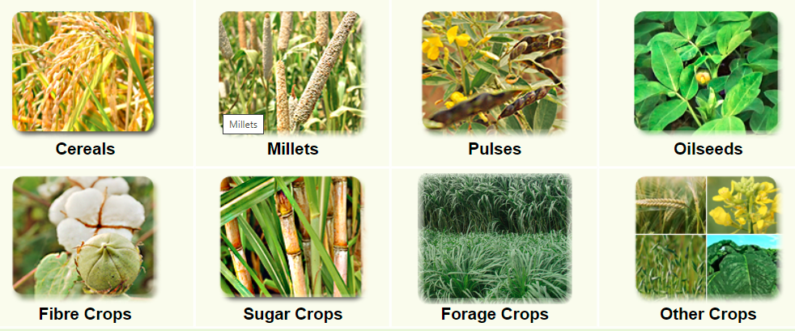
You may Choose from
Agriculture
Lakhpati Livelihoods
Opportunities
Choosing Right Activity
HH Preparedness

Slide 13
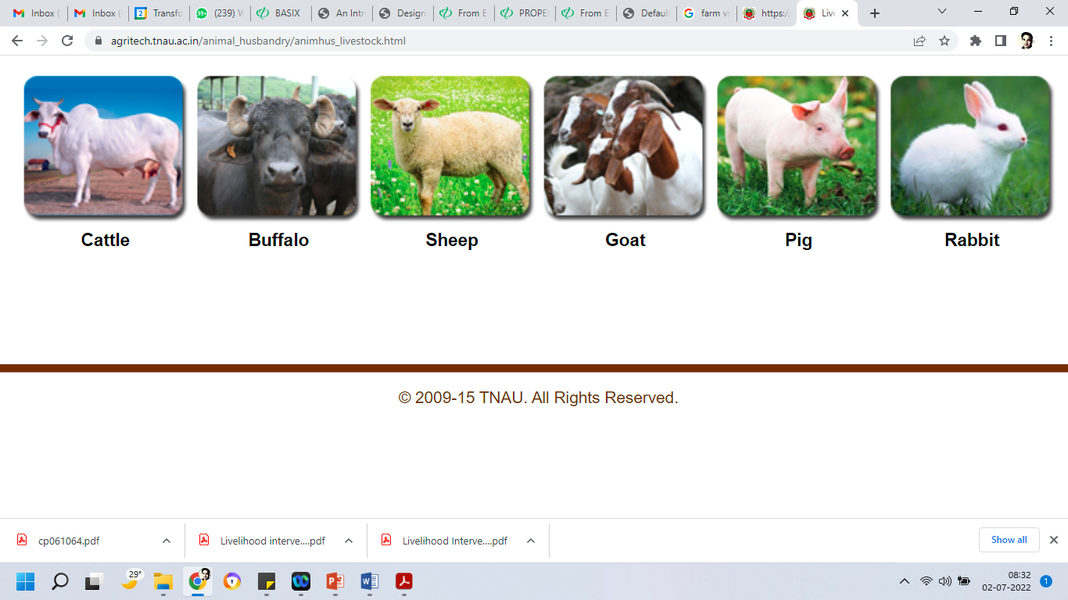
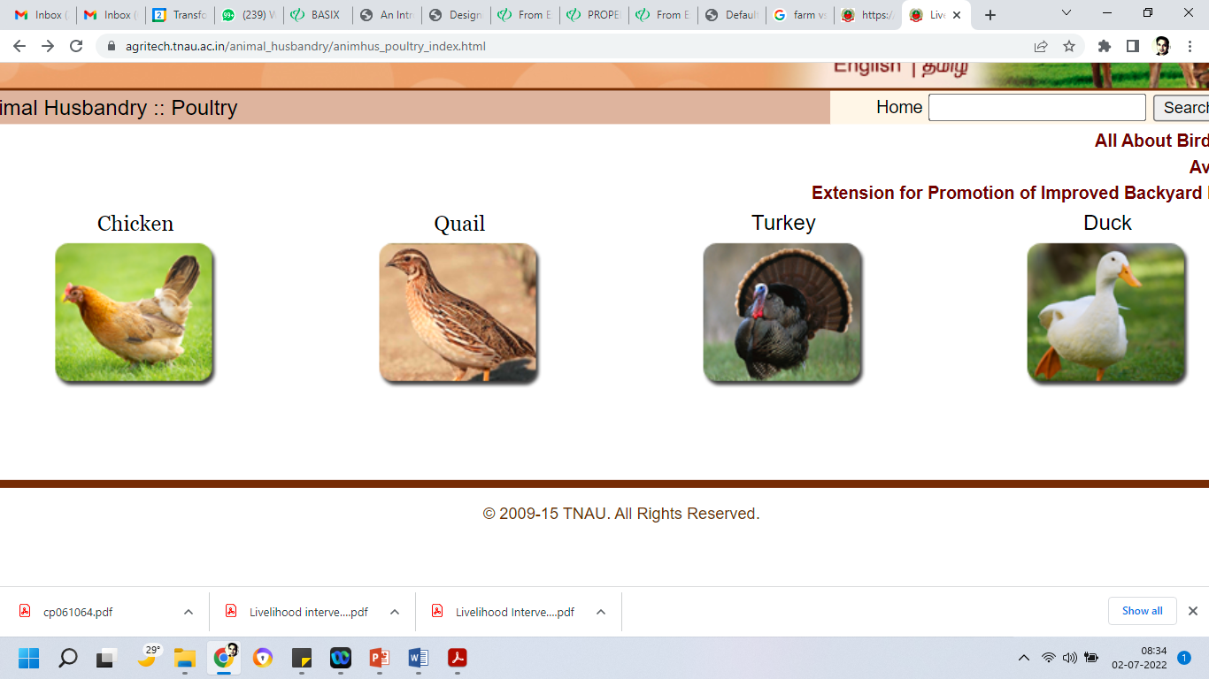
You may Choose from
Livestock
Lakhpati Livelihoods
Opportunities
Choosing Right Activity
HH Preparedness

Slide 14
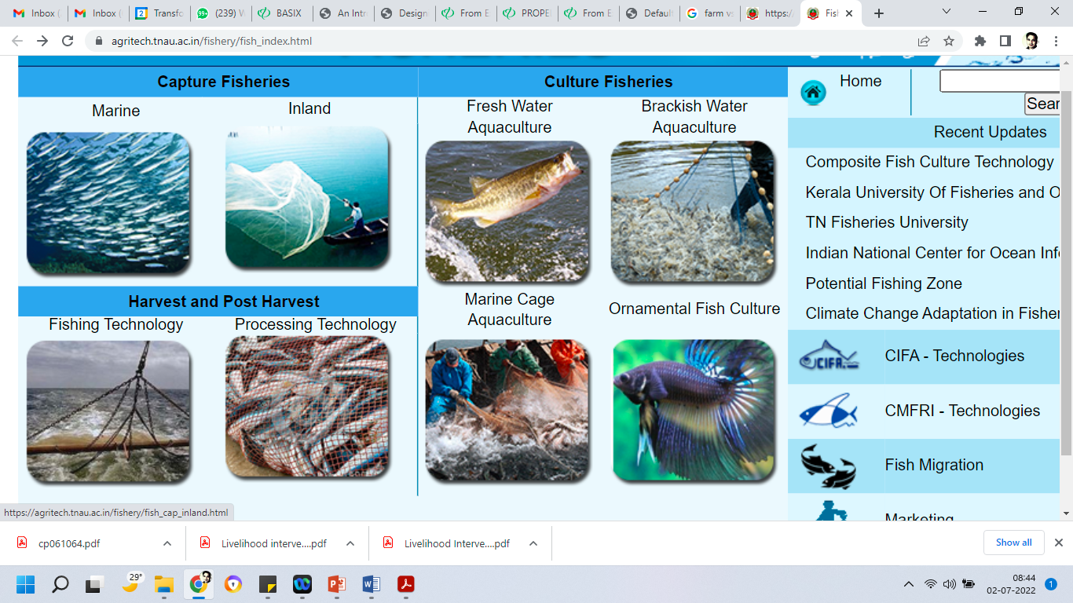
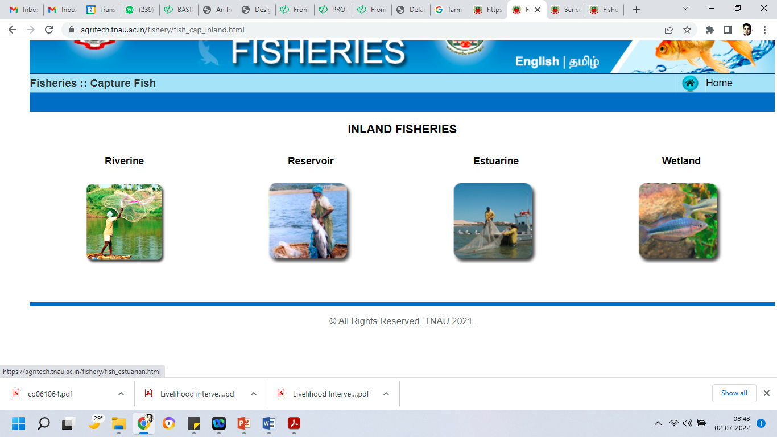
You may Choose from
Fishery
Lakhpati Livelihoods
Opportunities
Choosing Right Activity
HH Preparedness

Slide 15


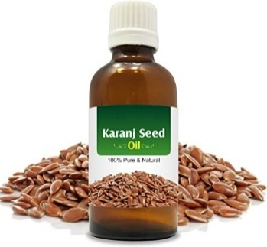
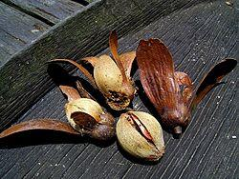
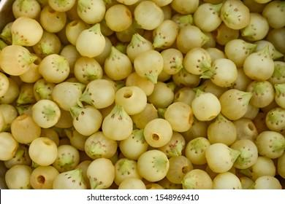
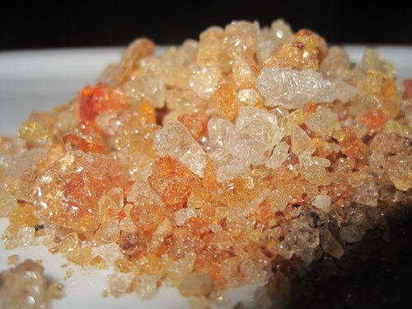
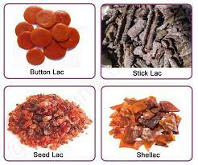
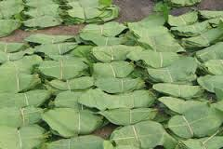
You may Choose from
NTFP
Honey | Neem Oil | Karanj Oil | Sal Seed
Mahua | Karaya gum | Lac | Tendu Leaves
Lakhpati Livelihoods
Opportunities
Choosing Right Activity
HH Preparedness

Slide 16

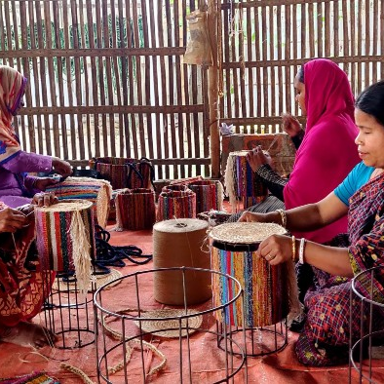

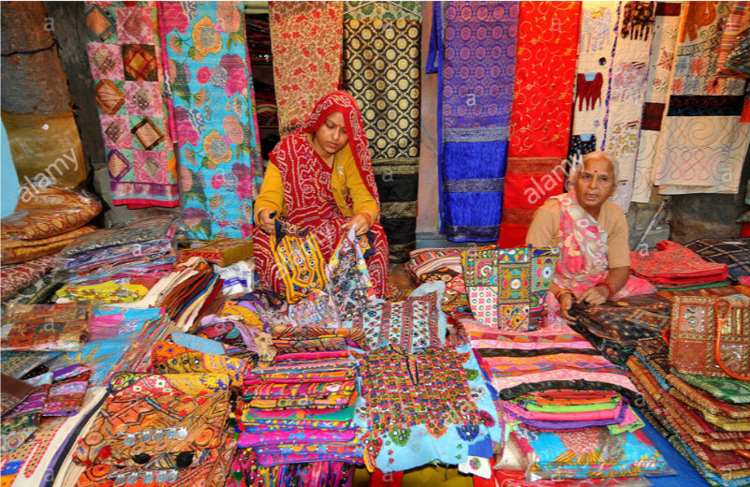
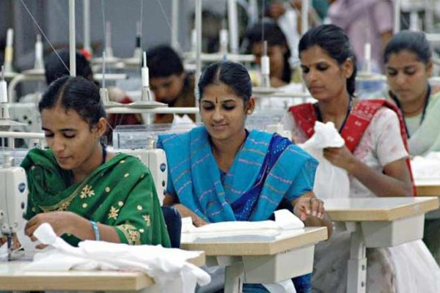
Non-Farm
Livelihood
Lakhpati Livelihoods
Opportunities
Choosing Right Activity
HH Preparedness

Slide 17


You may Choose from
Non-Farm
Manufacturing | Trading | Services
INDIVIDUAL
GROUP
Product Cluster
Sectoral Clusters
Lakhpati Livelihoods
Opportunities
Choosing Right Activity
HH Preparedness

Slide 18
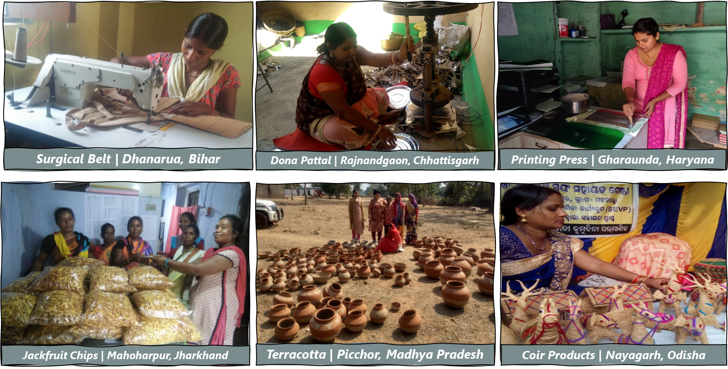
You may Choose from
Non-Farm
Lakhpati Livelihoods
Opportunities
Choosing Right Activity
HH Preparedness

Slide 19
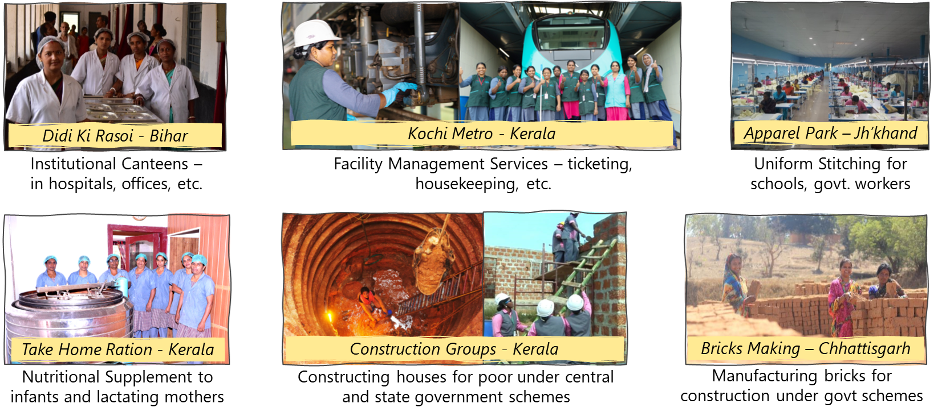
You may Choose from
Non-Farm - Ent.
Lakhpati Livelihoods
Opportunities
Choosing Right Activity
HH Preparedness

Slide 20
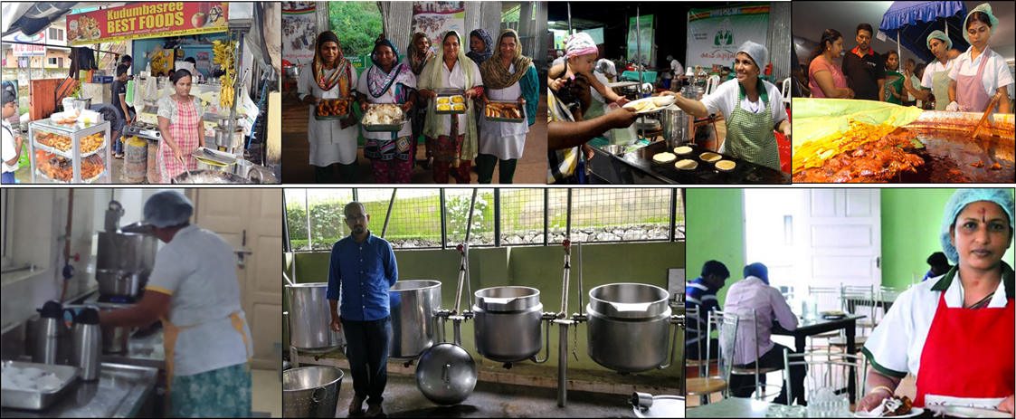
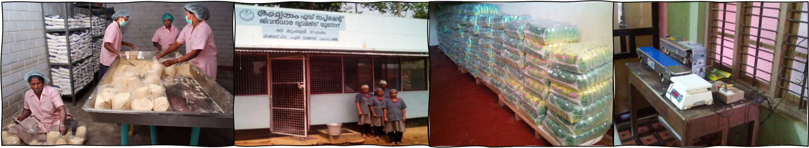
You may Choose from
Non-Farm - Ent.
CAFÉ Kudumbashree Catering Unit, Kerala
Take Home ration Packaging and Supply, Kerala, Odisha, Rajasthan, Bihar and Karnataka
Lakhpati Livelihoods
Opportunities
Choosing Right Activity
HH Preparedness

Slide 21

Model Prototypes
ICAR |  | Net Income
Kerala | Crop+ Dairy+ Organic Farming 0.4 Ha | 1.08 Lakh
Meghalaya | Crop + Lvestock (0.64 Ha) | 1.17 Lakh
Sikkim | Crop + Dairy+ Organic Farming (0.5Ha) | 1.37 Lakh
Tamilnadu | Crop + Livestock+ Fish (0.8 Ha) | 1.8 Lakh
Tamilnadu | Crop + Dairy (0.4 Ha) | 1.12 Lakh
Uttar Pradesh | Horticulture +Dairy (0.7 Ha) | 2.28 Lakh
Uttar Pradesh | Exhotic Vegetables (0.4 ha) | 2.03 Lakh
Andaman | Crop + Harticulture+ Livestock (0.75 Ha) | 2.14 Lakh

Slide 22
Livelihood Models
You can download it from here:
https://drive.google.com/drive/folders/1sCQXtGUJyS7M2JhO5ahIof9pWHf157DE?usp=sharing
Models prepared by NABARD:
https://drive.google.com/drive/folders/1mt5-5hq_2LPUKKmh7cks4NKBYPyq003S?usp=sharing

Slide 23
ANY QUERIES?
Lakhpati Livelihoods
Opportunities
Choosing Right Activity
HH Preparedness
Q & A

Slide 24
Thank you

